Slide 1
8
Chapter
Foundations of Individual Behavior
Copyright ©2011 Pearson Education

Slide 2
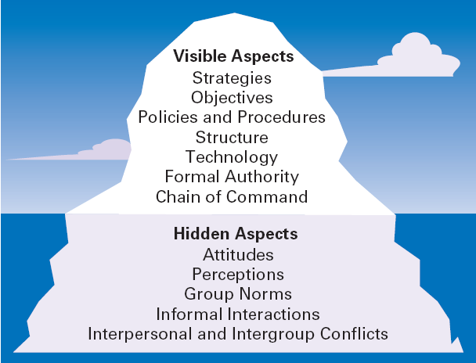
The Organization as an Iceberg
Notes:
Like an iceberg, OB has a small visible dimension and a much larger hidden portion. What we see when we look at an organization is its visible aspects: strategies, goals, policies and procedures, structure, technology, formal authority relationships, and chain of command.
But under the surface are other elements that managers need to understand

Slide 3
What Is Organizational Behavior?
The study of the actions of people at work.
The goals of OB are to explain, predict, and influence behavior.
Managers need to be able to
  explain why employees engage in some behaviors rather than others,
  predict how employees will respond to various actions and decisions,
  and influence how employees behave.

Slide 4
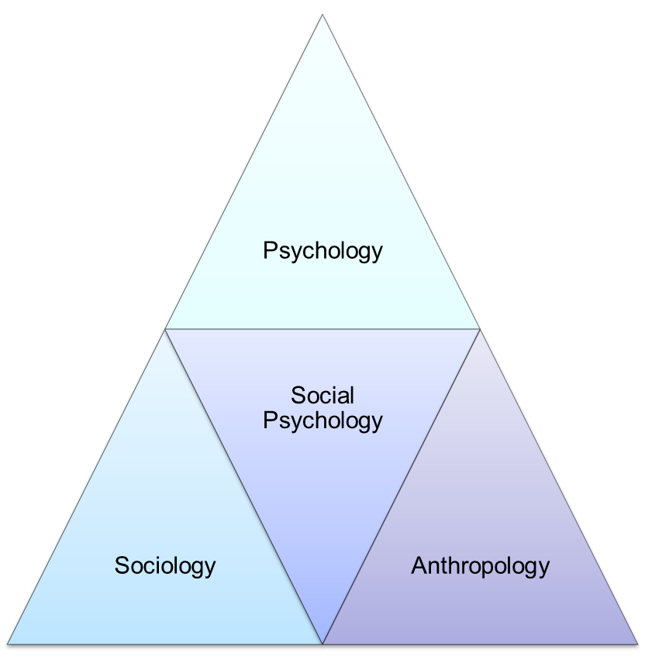
Many behavioral sciences have contributed to the development of Organizational Behavior.

Slide 5
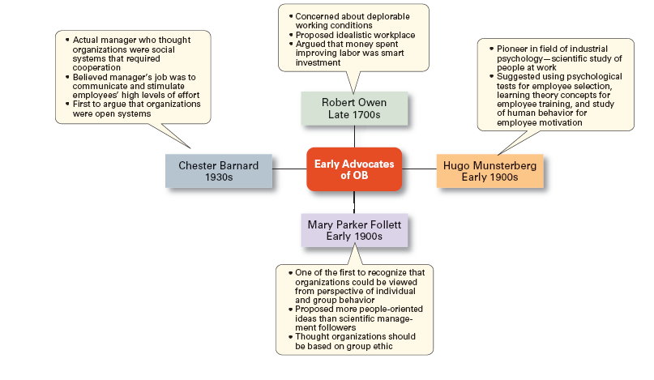
Early Advocates of OB

Slide 6
What is the Focus of OB?
What employee behaviors are we specifically concerned with explaining, predicting, and influencing? Six important ones have been identified:
Employee Productivity
  A performance measure of both work efficiency and effectiveness
Absenteeism
  The failure to show up for work (upto $660 per employee per year)

Slide 7
Focus of OB (cont.)
Turnover
  Voluntary and involuntary permanent withdrawal from an organization: incur high costs!
Organizational Citizenship Behavior
  Discretionary behavior that’s not part of an employee’s formal job requirements, but which promotes the effective functioning
Job Satisfaction
  An employee’s general attitude toward his or her job, it’s outcomes concerns many managers

Slide 8
Focus of OB (cont.)
Workplace Misbehavior
  Any intentional employee behavior that is potentially harmful to the organization or individuals within the organization
  Workplace misbehavior shows up in organizations in four ways: deviance, aggression, antisocial behavior, and violence.
  Such behaviors can range from playing loud music just to irritate coworkers to verbal aggression to sabotaging work, all of which can create havoc in any organization
Copyright ©201 Pearson Education

Slide 9
How Should Managers Deal with Negative Behavior in the Workplace?
  Rudeness, hostility, aggression, and other forms of workplace negativity have become all too common in today’s organizations.
  In a study, 10% of employees said they witnessed rudeness daily within their workplaces and 20 percent said that they personally were direct targets of incivility at work at least once a week.
  Managers cannot ignore these behaviors. What would you do as a manager?
  Preventing negative behaviors by carefully screening potential employees for certain personality traits and responding immediately and decisively to unacceptable negative behaviors can go a long way toward managing negative workplace behaviors.

Slide 10
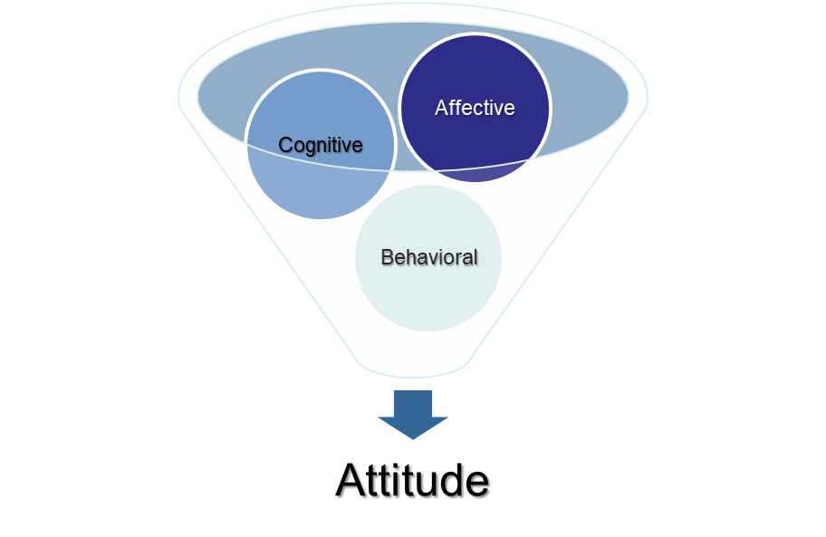
Attitudes
Evaluative statements or judgments concerning objects, people, or events.
Three components of an attitude:
The emotional or feeling segment of an attitude
The opinion or belief segment of an attitude
An intention to behave in a certain way toward someone or something

Slide 11
Attitudes
“Negative attitude toward the supervisor!”
Cognitive component (evaluation) “My supervisor gave a promotion to a co-worker who deserved it less than me.”
Affective Component (feeling)
“I dislike my supervisor!”
Behavioral Component (action) “I’m looking for another job; I’ve complained about my supervisor to anyone who would listen.”

Slide 12
Attitude and Behavior (cont.)
Job Involvement
  The degree to which an employee identifies with his or her job, actively participates in it, and considers his or her job performance important for self-worth
Organizational Commitment
  Represents an employee’s orientation toward the organization in terms of his or her loyalty to, identification with, and involvement in the organization

Slide 13
A Concept Generates Big Interest
Employee Engagement
  When passionate about and deeply connected, satisfied with, and enthusiastic about their jobs employees are
  2.5 times more likely be top performers
  much less likely to leave

Slide 14
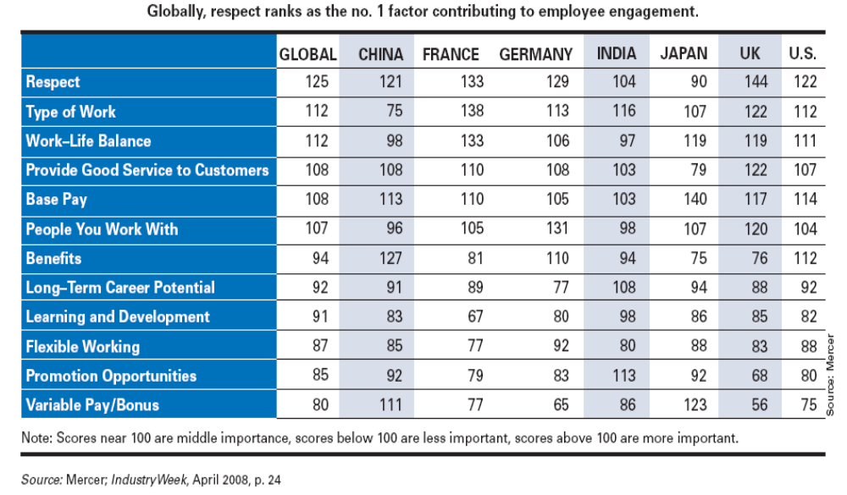
The exhibit lists the key engagement factors found in a global study of over 12,000 employees done by a consulting company.

Slide 15
Does Behavior Always Follow from Attitudes?
Leon Festinger, in the 1950s, sought to explain the relationship between attitudes and behavior
Cognitive Dissonance Theory
  Any incompatibility or inconsistency between attitudes or between behavior and attitudes
  inconsistency is uncomfortable and that individuals will try to reduce the discomfort and thus, the dissonance

Slide 16
*Desire to reduce the inconsistency is determined by three factors:
- Importance of the elements creating the dissonance
ex.: Saving money by dumping the dirty water of the factory to the river vs. being against pollution (change behavior/attitude or ignore)
- Degree of influence, individual believes s/he has over the elements ex.: Boss’s directive
- Rewards that are involved in dissonance
High rewards for high dissonance tend to reduce the tension ex.: Hate the job – earn so much money

Slide 17
MYTH OR SCIENCE? –
“Deep Down, People Are All Alike”
This statement is essentially false. All people have values, attitudes, likes and dislikes, feelings, goals, and similar general attributes, but individual differences are far more illuminating. People differ in intelligence, personality, abilities, ambition, motivations, emotional display, values, priorities, expectations, and the like. Your ability to predict behavior will be limited if you assume everyone is like you.
Take the task of selecting among job applicants. Recognize that jobs differ in terms of demands and requirements. Interview and test applicants to:
  Categorize them by specific traits.
  Assess job tasks in terms of the type of personality best suited for effectively completing those tasks.
  Match applicants and job tasks to find an appropriate fit.
  Using an individual-difference variable, managers improve the likelihood of identifying and hiring high-performing employees.

Slide 18
What is Personality?
The sum total of ways in which an individual reacts and interacts with others,
The measurable traits a person exhibits
A dynamic organization of psycho-physical characteristics that determines a person’s unique adjustment to environment

Slide 19
Measuring Personality
Helpful in hiring decisions
Common and useful method: self-report surveys
    self evaluating on a series of factors
    impression management disadvantage
Observer-ratings surveys provide an independent assessment of personality – often better predictors

Slide 20
Personality Determinants
Heredity or Environment?
  Heredity approach argues that genes are the source of personality and parental upbringing don’t add much
  Factors determined at conception: physical stature, facial attractiveness, gender, temperament, muscle composition and reflexes, energy level, and bio-rhythms
  There is some personality change over long time periods!
  Twin studies: raised apart but very similar personalities

Slide 21
Personality Traits
Enduring characteristics that describe an individual’s behavior
  The more consistent the characteristic and the more frequently it occurs in diverse situations, the more important the trait.
Two dominant frameworks used to describe personality in business:
  Myers-Briggs Type Indicator
  Big Five Model

Slide 22
What Do Managers Need to Know About Personality?
Personality
  A unique combination of emotional, thought, and behavioral patterns that affect how a person reacts to situations and interacts with others
Myers-Briggs Type Indicator (MBTI)
  A personality assessment that uses four dichotomies of personality to identify different personality types
Notes:
Personality is most often described in terms of measurable traits that a person exhibits.
One of the more widely used methods of identifying personalities is the Myers-Briggs Type Indicator (MBTI®). The MBTI® assessment
uses four dichotomies of personality to identify 16 different personality types based on the responses to an approximately 100-item questionnaire.

Slide 23
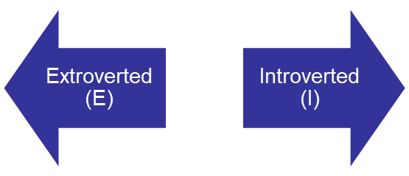
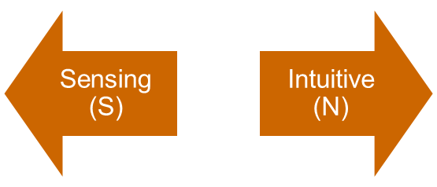
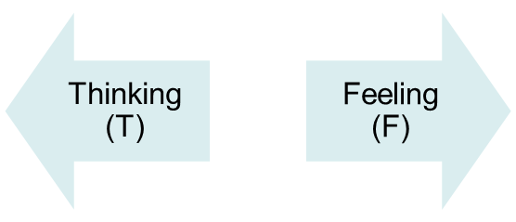
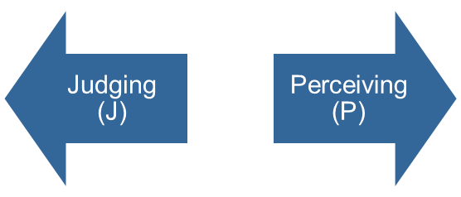
Myers-Briggs Type Indicator
Most widely used instrument in the world (approx. 100 questions)
Participants are classified on four axes to determine one of 16 personality types, such as ENTJ.
Quiet and
Shy
Sociable and Assertive
Unconscious Processes; Looks at Big-picture
Practical, Detail,
Orderliness
Uses Values & Emotions
Use Reason
and Logic
Want Order
& Structure
Flexible and Spontaneous

Slide 24
The Types and Their Uses
Each of the sixteen possible combinations has a name, for instance:
  Visionaries (INTJ) – original, stubborn, and driven
  Organizers (ESTJ) – realistic, logical, analytical, and businesslike
  Conceptualizer (ENTP) – entrepreneurial, innovative, individualistic, and resourceful
  http://www.humanmetrics.com/cgi-win/JTypes2.asp
Research results on validity mixed.
  MBTI is a good tool for self-awareness and counseling.
  Should not be used as a selection test for job candidates.

Slide 25
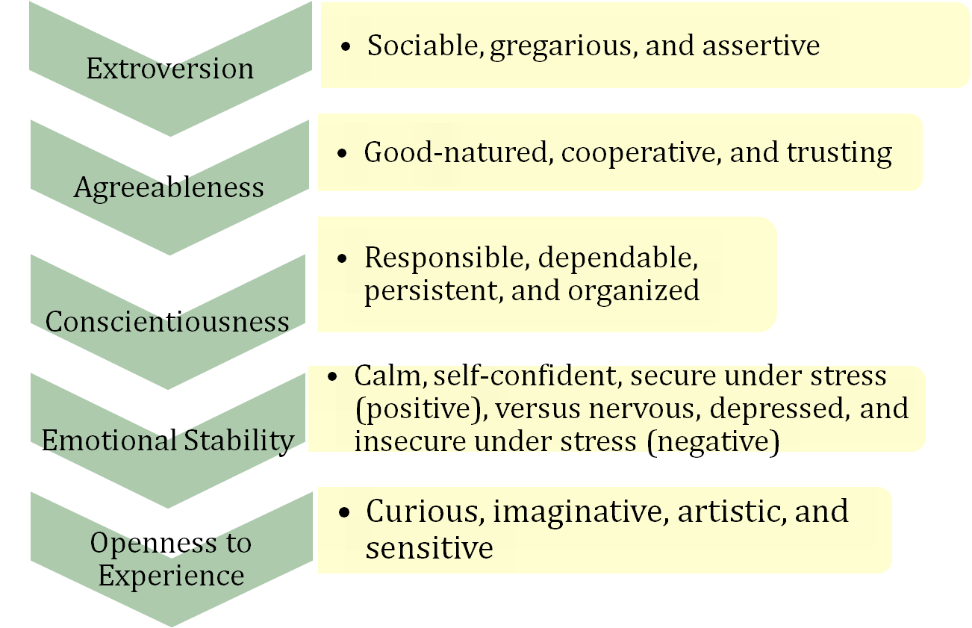
What is The Big Five Model?
  A personality trait model that examines five traits:

Slide 26
Model of How Big 5 Traits Influence OB Criteria
Big 5 Trait | Why is it relevant? | What does it affect?
Emotional stability | Less negative thinking and fewer negative emotions Less hyper-vigilant | Higher job & life satisfaction Lower stress levels
Extraversion | Better interpersonal skills Greater social dominance More emotionally expressive | Higher performance Enhanced leadership Higher job & life satisfaction
Openness | Increased learning More creative More flexible & autonomous | Training performance Enhanced leadership More adaptable to change
Agreeable-ness | Better liked More conforming Being cooperative | Higher performance Lower levels of deviant behavior
Conscientious-ness | Greater effort & persistence More drive and discipline Better organized& planning | Higher performance Enhanced leadership Greater longevity
Notes:
Conscientiousness [ÖZDİSİPLİN]

Slide 27
Research has shown the Big Five Model to be a better framework.
O Openness to new experience
C Conscientiousness
E Extroversion
A Agreeableness
N Neuroticism / Emotional stability
Do frameworks like Big Five transfer across cultures?
    Yes, but the frequency of type in the culture may vary.
    Better in individualistic than collectivist cultures.

Slide 28
How to choose an expatriate?
Which personality traits can be useful in this endeavor?
Big Five Dimensions:
    Extraversion
    Agreeableness
    Conscientiousness
    Emotional stability
    Openness to experience
Core self-evaluation
Machiavellianism
Self-monitoring
Risk taking
Proactive Personality
Type A Personality

Slide 29
Which Are Most Important for You?
1. Adaptability | 21. Decisiveness
2. Stability | 22. Being competitive
3. Being reflective | 23. Being highly organized
4. Being innovative | 24. Achievement orientation
5. Being quick to take advantage of opportunities | 25. Having a clear guiding philosophy
6. Taking individual responsibility | 26. Being results oriented
7. Risk taking | 27. Having high performance expectations
8. Opportunities for professional growth | 28. Being aggressive
9. Autonomy | 29. High pay for good performance
10. Being rule oriented | 30. Security of employment
11. Being analytical | 31. Offers praise for good performance
12. Paying attention to detail | 32. Being supportive
13. Confronting conflict directly | 33. Being calm
14. Being team oriented | 34. Developing friends at work
15. Sharing information freely | 35. Being socially responsible
16. Being people oriented | 36. Enthusiasm for the job
17. Fairness | 37. Working long hours
18. Not being constrained by many rules | 38. Having a good reputation
19. Tolerance | 39. An emphasis on quality
20. Informality | 40. Being distinctive / different from others

Slide 30
Linking Personality to Workplace
In addition to matching the individual’s qualifications fitting to a job, managers should also be concerned with:
  The employee’s personality must fit with the organizational culture.
  Can use the information about personality types to match it with the organizational culture.
  Mismatches almost surely will result in turnover.

Slide 31
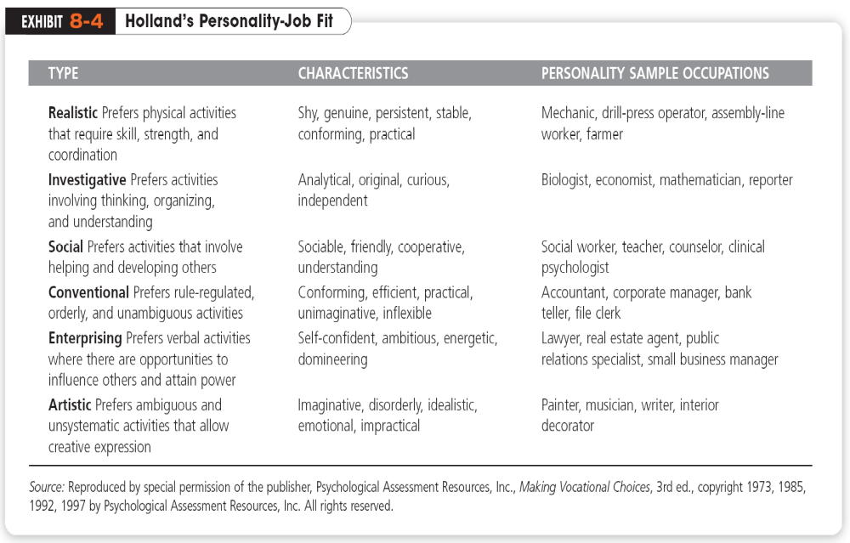
Personality & Occupations

Slide 32
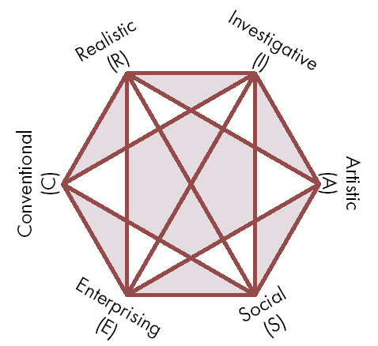
Relationships Among Personality Types
The closer the occupational fields, the more compatible.
The further apart the fields, the more dissimilar.
Need to match personality type with occupation.
Source: Reprinted by special permission of the publisher, Psychological Assessment Resources, Inc., from Making Vocational Choices, copyright 1973, 1985, 1992 by Psychological Assessment Resources, Inc. All rights reserved.

Slide 33
Personality Traits Relevant to OB
Self-Esteem or Core Self-Evaluation
  The degree to which people like/dislike themselves
  Positive self-evaluation leads to higher job performance
Machiavellianism
  A pragmatic, emotionally distant power-player who believes that ends justify the means.
  High Machs are manipulative, win more often, and persuade more than they are persuaded.
    Flourish when have direct interaction
    Work with minimal rules and regulations
    Emotional involvement is irrelevant to winning

Slide 34
Personality and Work Behavior (cont.)
Locus of Control
  The degree to which people believe they control their own fate
    Attribution of events to an internal/external source
    Internals believe they are in charge of their decisions and behaviors
    Externals tend to perceive that the world happens to them
  Internals often have higher self-efficacy feeling
    Associated with better performance, and satisfaction with outcome, higher success, greater tolerance of frustration
Notes:
People differ in the degree to which they like or dislike themselves. This trait is called self-esteem (SE).
Another personality trait researchers have identified is called self-monitoring. Individuals high in self-monitoring can show considerable adaptability in adjusting their behavior to external, situational factors. They’re highly sensitive to external cues and can behave differently in different situations

Slide 35
Self-Monitoring
  The ability to adjust behavior to meet external, situational factors.
    High monitors conform more and are more likely to become leaders.
    Show less commitment to their organizations.
Risk Taking
  The willingness to take chances.
  May be best to align propensities with job requirements.
  Risk takers make faster decisions with less information.

Slide 36
More Relevant Personality Traits
Narcissism
  An arrogant, entitled, self-important person who needs excessive admiration.
  Less effective in their jobs.
  They thought they were better leaders than their colleagues and supervisors rated worse
  Proactive Personality
  Identifies opportunities, shows initiative, takes action, and perseveres to completion
  Creates positive change in the environment; entrepreneurial initiative

Slide 37
What Is Emotional Intelligence?
(EI)
  refers to an assortment of non-cognitive skills, capabilities, and competencies that influences a person’s ability to cope with environmental demands and pressures
  The ability to notice and to manage emotional cues and information
Notes:
Emotional intelligence (EI)

Slide 38
Five Dimensions of EI
  Self-awareness
    Being aware of what you’re feeling.
  Self-management
    The ability to manage your own emotions and impulses
  Self-motivation
    The ability to persist in the face of setbacks and failures
  Empathy
    The ability to sense how others are feeling
  Social skills
    The ability to handle the emotions of others

Slide 39
Could there be gender differences in EI?
  Women score often higher than men on measures of empathy and social skills
  Men often outperform women on stress tolerance and self-awareness measures.
Women and men can be equally as intelligent
  emotionally, but they’re strong in different
  areas.

Slide 40
What is Perception and What Influences It?
A process by which we give meaning to our environment by organizing and interpreting sensory impressions
  Research on perception consistently demonstrates that individuals may look at the same thing yet perceive it differently.
  The way we perceive the world as more important than the actual information transmitted.
Notes:
And selecting!

Slide 41
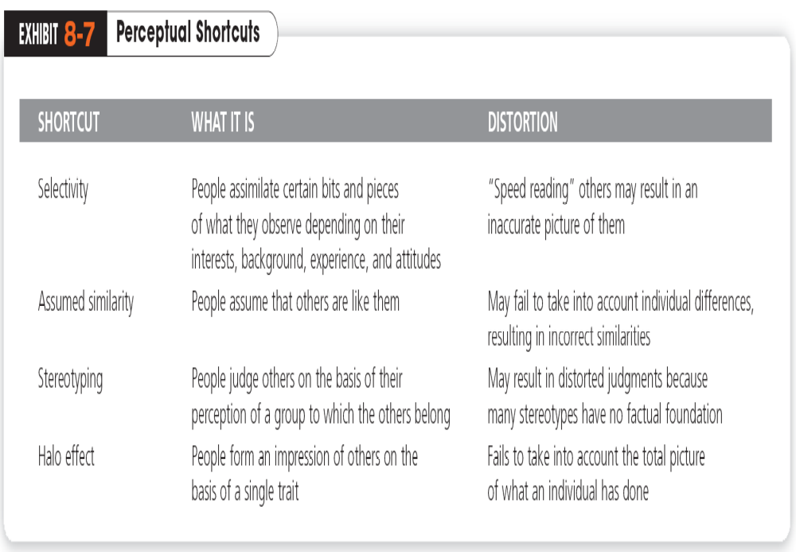

Slide 42
Attribution Theory
  A theory used to explain how we judge people differently, based on what meaning we attribute to a given behavior
  Basically, the theory suggests that when we observe an individual’s behavior, we attempt to determine whether it was internally or externally caused

Slide 43
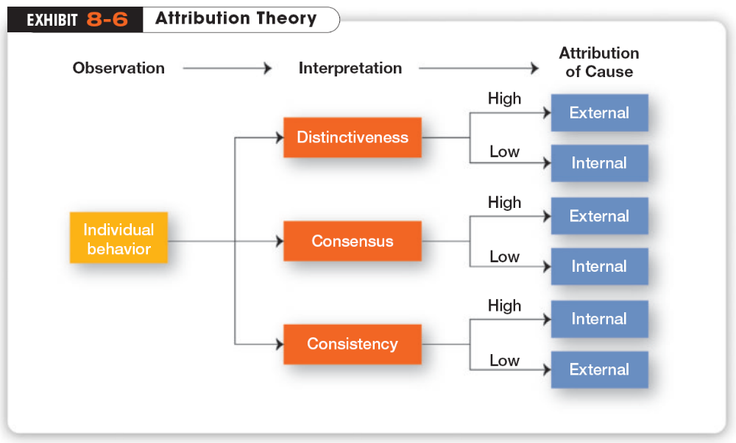
Copyright ©201 Pearson Education
Notes:
Exhibit 8-6 summarizes the key elements in attribution theory

Slide 44
Can Attributes Be Distorted?
Fundamental Attribution Error
  The tendency to underestimate the influence of external factors and overestimate the influence of internal factors when making judgments about the behavior of others
Self-Serving Bias
  The tendency for individuals to attribute their successes to internal factors while putting the blame for failures on external factors
Notes:
For instance, substantial evidence supports the hypothesis that when we make judgments about the behavior of other people, we have a tendency to underestimate the influence of external factors and overestimate the influence of internal or personal factors. This fundamental attribution error can explain why a sales manager may be prone to attribute the poor performance of her sales agents to laziness rather than to the innovative product line introduced by a competitor
Individuals also tend to attribute their own successes to internal factors such as ability or effort while putting the blame for failure on external factors such as luck. This self-serving bias suggests that feedback provided to employees in performance reviews will be predictably distorted by them, whether it is positive or negative

Slide 45
Does Learning Explain Behavior?
Learning
  A relatively permanent change in behavior that occurs as a result of experience.
  Learning occurs all the time, as we continuously learn from our/others experiences.
Operant Conditioning
  A theory of learning that says behavior is a function of its consequences
  People learn to behave to get something they want or to avoid something they don’t want
Notes:
The psychologists’ definition of learning is considerably broader than the average person’s view that “it’s what we do in school.” A workable definition of learning is any relatively permanent change in behavior that occurs as a result of experience.

Slide 46
Managerial Assumptions and Its Limits
Operant conditioning can be seen in work settings as well and smart managers quickly recognize that they can use operant conditioning to shape employees’ behaviors to get work done in the most effective and efficient manner possible.
People are motivated by reward and punishment.
  Social systems work best with a clear chain of command, managers guide their followers in the direction of established goals by clarifying role and task requirements.
  When people have agreed to do a job, a part of the deal is that they accept authority of to their manager.
  The prime purpose of a subordinate is to do what their manager tells them to do.
The main limitation is the assumption of 'rational man', a person who is largely motivated by money and simple reward, and hence whose behavior is predictable.

Slide 47
Shaping behavior
  The process of guiding learning in graduated steps, using reinforcement or lack of reinforcement
  Operant conditioning: people behave the way they do so they can get something they want or avoid something they don’t want. It’s voluntary or learned behavior.
  People will most likely engage in desired behaviors if they’re positively reinforced.

Slide 48
What Is Social Learning Theory?
A theory of learning that says people can learn through observation and direct experience
  Much of what we have learned comes from watching others (models)—parents, teachers, peers, television and movie actors, and managers
  Managers should be concerned with how they can teach employees to behave in ways that most benefit the organization.

